Slide 1

Flatiron Module 1 Project: King County House Prices

Slide 2

Hello!
My name is Kiarash Ahmadi
I’m an aspiring Data Scientist with Flatiron Academy. I am also pursuing a Master’s in Computational Science & Engineering at Georgia Tech.

Slide 3
Project Background
King County Housing Sales from 2014-2015
Model predicts housing prices based off different features
Clean, Explore, and Model with Multi-Linear Regression

Slide 4
Questions to be answered
1. How does the quality of a house affect prices?
How can I quantify quality from the variables within the dataset?
2. What is a view’s impact on house prices?
It’s widely assumed that a view generally leads to higher housing prices.
3. Does location matter the most? If not what?
It was initially suspected that location affects housing prices the most.

Slide 5
How do I quantify quality?
Grades 1-6: Below Average
Poor construction
Simple Design
Older
Barely meets or fails to meet minimum building standards
Grades 7-9: Average
Average to just above average design and construction
Better materials in interior and exterior finish work
Grades 10-13: Above Average
High quality features and materials
Custom, detailed design
More luxurious options

Slide 6
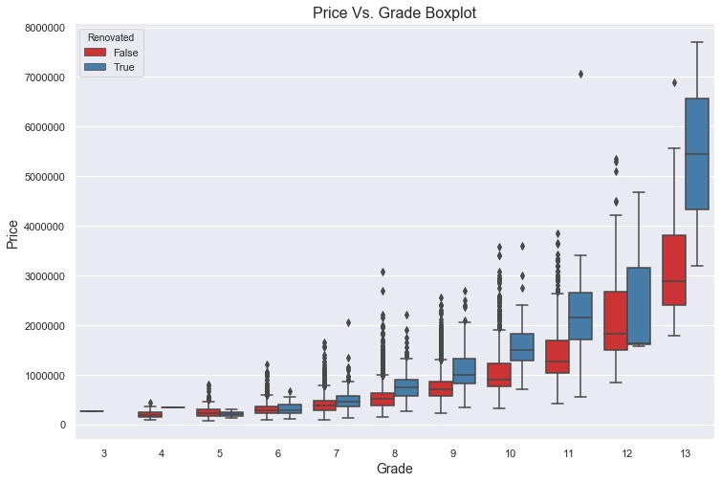
How does the quality of a house affect prices?
Model indicates that a 10% increase in an above average grade leads to a 7.66% increase in price.
Renovated homes tend to have higher values when compared to their peers

Slide 7
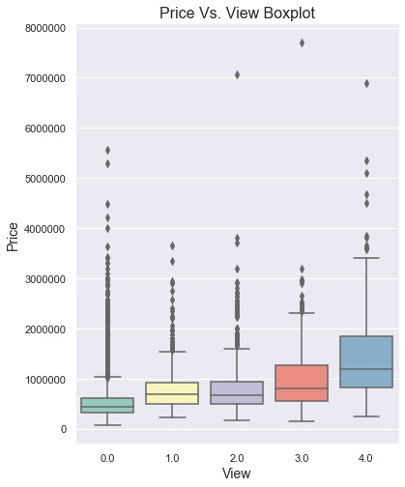
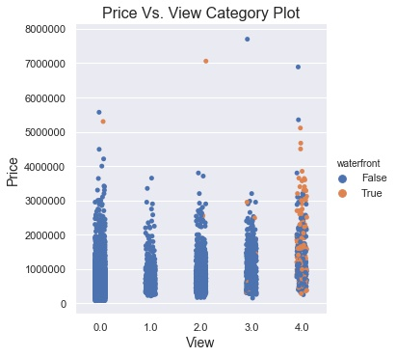
What is a view’s impact on house prices?
10% increase in views 3-4 leads to 7.65% increase in price
A 10% increase in views 0-2 causes a 3.52% increase in price.
Notes:
Mention waterfront 6.09

Slide 8
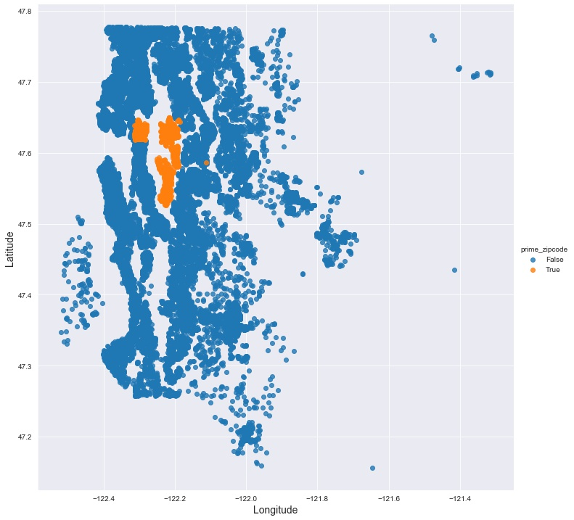
Does Location Matter the Most?
Determined the top 4 zipcodes and their locations
Found distance of each house from average coordinates of houses in the top 4 zipcodes

Slide 9
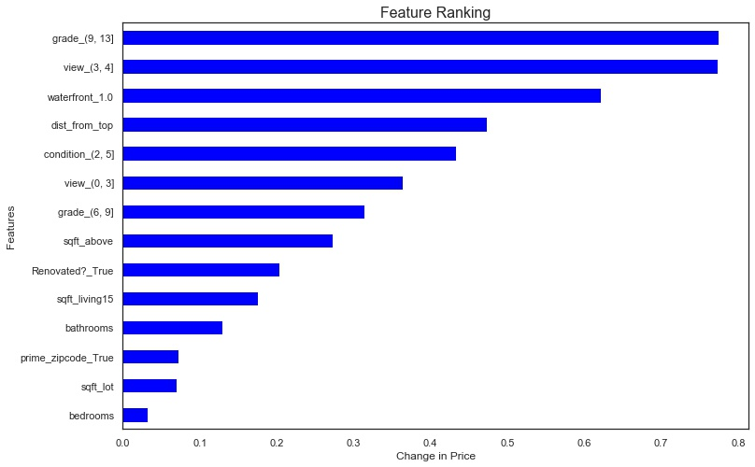
If Not, What does?
A 10% increase in distance from the top zipcodes causes a 4.61% decrease in price
Grades 9-13 cause the most change in price
Square footage is less impactful than expected

Slide 10
Future Work
Develop Scores
Create a quality and view score using the view, grade, renovation, and waterfront predictor variables
Quantifying Location
Improve how the model measured a good location beyond just its distance from the top zip codes.
Incorporate Interactions
Introduce new variables that account for the interactions among predictors

Slide 11

Thanks!
Any questions?
You can find me at:
mkiah09@gmail.com

